Slide 1

Kundan Band | Ravindra Choudhary | Aditya Sirsalkar | Ansh Kumar | Rajan patil
Technical Communication Skills
presentation

Slide 2
What is Artificial Rain?
ARTIFICIAL RAIN , ALSO KNOW AS CLOUD SEEDING , IS A TECHNIQUE USED TO ENHANCE PRECIPITATION FROM CLOUDS . IT INVOLVES THE INTRODUCTION OF SUBSTANCES INTO THE ATMOSPHERE THAT ACT AS A CLOUD CONDENSATION OR ICE NUCLEI, WHICH FACILITATE THE FORMATION OF RAINDROPS OR SNOWFLAKES.

Slide 3
PROBLEM
SOLUTION
Droughts
Agricultural Stress
Water Resource Management
Tourism and Recreation
Hydroelectric Power Generation
Tourism and Recreation
Forest Fire Prevention
Artificial Rain

Slide 4
CONTENTS
HISTORY AND DEVELOPMENT
TECHNIQUES OF CLOUD SEEDING
METHODS OF DISPERSAL
APPLICATIONS
EFFECTIVENESS AND CONTROVERSIES
GLOBAL USE

Slide 5
HISTORY AND DEVELOPMENT
EARLY EXPERIMENT: THE CONCEPT OF CLOUD SEEDING WAS FIRST EXPLORED IN THE 1940s BY DR. VINCENT SCHAEFER AND IRVING LAMGUIR IN THE UNITED STATES. THEY DISCOVERED THAT INTRODUCING DRY ICE (SOLID CARBON DIOXIDE) INTO THE CLOUDS COULD INITIATE PRECIPITATION.
SILVER IODIDE: BERNARD VONNEGUT, ANOTHER RESEARCHER, LATER DISCOVERED THAT SILVER IODIDE COULD ALSO BE USED AS A SEEDING AGENT, AS IT HAS A CRYSTALLINE STRUCTURE SIMILAR TO ICE.

Slide 6
TECHNIQUES OF CLOUD SEEDING
STATIC CLOUD SEEDING: THIS INVOLVES DISPERSING CLOUD SEEDING AAGENTS LIKE SILVER IODIDE OR POTASSIUM IODIDE INTO CLOUDS. THESE PARCTICLES PROVIDE A SURFACE FOR WATER VAPOR TO CONDENSE INTODROPLETS, LEADING TO RAIN.
DYNAMIC CLOUD SEEDING: THIS METHOD AIMS TO INCTEASE AIR TURBULENCE TO PROMOTE THE VERTICAL GROWTH OF CLOUDS, WHICH CAN ENHANCE PRECIPITATION.
HYGROSCOPIC CLOUD SEEDING: IN THIS TECHNIQUE, SUBSTANCES LIKE SODIUM CHLORIDE (TABLE SALT) ARE USED TO ENCOURAGE THE FORMATION OF LARGER DROPLETS, WHICH CAN MERGE AND FALL AS RAIN.

Slide 7
How Cloud seeding works
IDENTIFICATION OF SUITABLE CLOUDS
SEEDING AGENTS
DISPERSAL METHODS

Slide 8
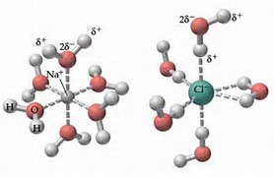
SEEDING AGENTS
EXAMPLES OF SEEDING AGENT ARE : AgCL , NaCL (COMMON SALT), KCL …

Slide 9
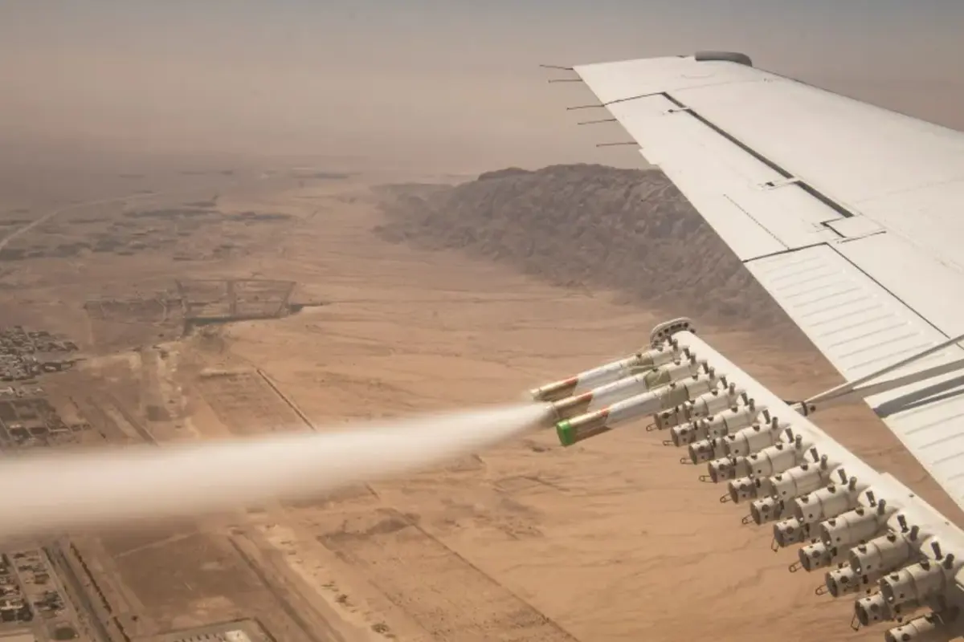
METHODS OF DISPERSAL
AIRCRAFT: AIRPLANES EQUIPED WITH FLARES OR OTHER DEVICES ARE USED TO RELEASE SEEDING MATERIALS INTO CLOUD.
GROUND-BASED GENERATORS: THESE DEVICES BURN THE SEEDING AGENTS, RELEASING PARTICLES THAT ARECARRIED UP TO THE CLOUDS BY AIR CURRENTS.
ROCKET DISPERSAL: ROCKETS ARE USED TO DELIVER SEEDING AGENTS DIRECTLY INTO CLOUDS, A METHOD DIRCTLY USED IN COUNTRIES LIKE CHINA.

Slide 10
APPLICATIONS
AGRICULTURE: ARTIFICIAL RAIN IS USED IN DROUGHT-PRONE AREAS TO ENHANCE CROP PRODUCTION.
WATER RESOURCE MANAGEMENT: IT IS EMPLOYED TO INCREASE WATER SUPPLY IN RESERVOIRS, LAKES, AND RIVERS.
HAIL SUPPRESSION: CLOUD SEEDING CAN ALSO BE USED TO REDUCE THE SIZE OF HAILSTONES IN THUNDERSTORMS, MINIMIZING DAMAGE TO CROPS AND PROPERTY.

Slide 11
Effectiveness and controversies
Effectiveness: The effectiveness of cloud seeding varies depending on atmospheric conditions, the type of clouds, and the technique used. While some studies report positive results, others indicate that the impact may be minimal.
Environmental Concerns: There are concerns about the environmental impact of the chemicals used, such as silver iodide. However, studies have generally shown that the levels used in cloud seeding are not harmful.
Ethical and Legal Issues: Questions arise regarding the ownership and manipulation of weather, especially when it comes to cross-border impacts or unintended consequences.

Slide 12
Global use
United States: The U.S. has a long history of cloud seeding, particularly in the western states where water scarcity is a concern.
China: China has one of the most extensive cloud seeding programs in the world, often used for both agricultural purposes and events like the Beijing Olympics to ensure clear skies.
Other Countries: Countries like Australia, Israel, Russia, and the UAE also have active cloud seeding programs, primarily for enhancing rainfall and managing water resources.

Slide 13
Recent developments
Technology Advancements: Modern advancements include the use of drones and AI to improve the precision and effectiveness of cloud seeding.
Climate Change Considerations: As climate change impacts weather patterns, the use of artificial rain is increasingly considered as part of broader water management strategies.

Slide 14
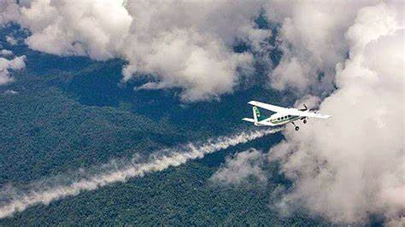

Summary
Cloud seeding remains a field of active research and development, with ongoing debates about its efficiency, environmental impact, and ethical implications.

